Slide 1

Implementing
Electronic Timekeeping

Slide 2
Why Are We Using This System
Track hours appropriately
Provides a shared database for the entire Archdiocese
Calculate overtime appropriately
Track shared employees in one database
Automates offering benefits when employees become eligible
Prepares locations for upcoming FLSA changes

Slide 3
How Will We Use the System
Hourly employees will clock in and out
Salaried employees will use schedules to populate their timesheets
Supervisors will approve hourly and salaried timecards electronically
Supervisors will approve time off electronically
Payroll processors will import time into the pay grid using a file

Slide 4
System Rules
Employees are assigned to one of three payroll policies:
  Hourly Full Time, Hourly Part Time, or Salary
Punches will round to the nearest 15 minutes
  Example: 8a-8:07am will round to 8am and 8:08-8:15am will round to 8:15am
Hourly Employees will punch out for lunch
The work week begins on Sunday and ends on Saturday.
Hourly Employees will qualify for overtime if they work more than 40 hours in a work week.
Salaried employees timesheets auto populate with schedules.
The system will be set to apply a pre-determined amount of time for lunch. For example, this may be 30 or 40 minutes at your location.
The lunch period will automatically deduct from the salary schedules, so this must be taken into consideration when setting those schedules.

Slide 5
Overview of Implementation Process
General Introduction to System
Assigned a Paylocity Implementation Rep
Web Time Rep Sends Welcome Email
Rep Schedules Short Intro Phone Call
  Review questionnaire & set training dates
Locations
  Train employees | Install Needed Equipment | Complete Admin Training
Location guided through two successful payrolls using time import file from Web Time.

Slide 6
Training
Employees Training is Minimal and only requires
  The employee to have access to their employee self service portal through a PC
  Or access to a tablet to use either their employee ID or self-service login information
Supervisors are trained to perform three functions
  Manage missed punches
  Approve timecards timely each pay period
  Approve or deny time off Requests as they arrive
Payroll processor is trained to import file

Slide 7
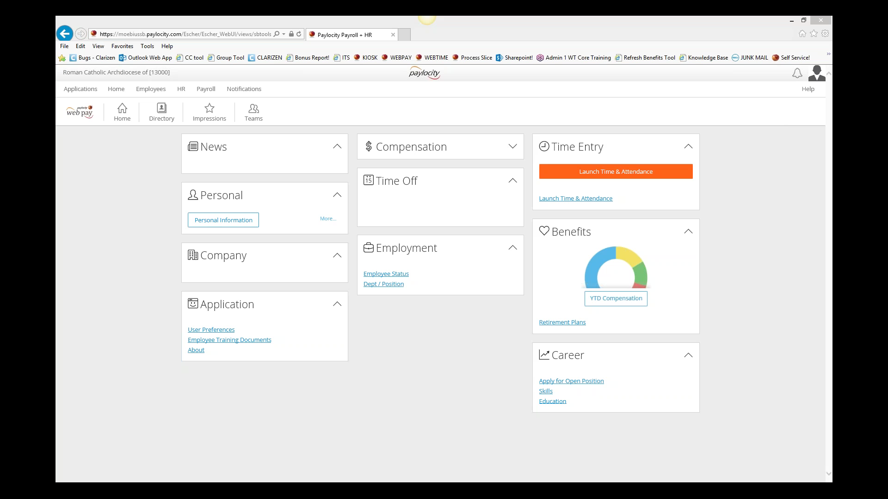
Preview The System

Slide 8
How To Prepare for Implementation
Ensure all employees can access their employee self-service portal.
Prepare schedules for salaried employees.
Consider how employees will clock in and out. Do you have any equipment needs.
Ensure all employees have an assigned supervisor in Web Pay.
Review and prepare to provide the locations time off policy to Web Pay.
Review and prepare to provide the locations holiday listings.
Prepare to have time off balances available and ready to load to the system.

Slide 9
Next Steps
Your location information will be provided to Paylocity’s Web Time Implementation Team
Your location will be assigned an implementation representative
The representative will reach out to you to schedule your welcome phone call.
You may use the preparation list in the previous slide and the Web Time Implementation document to start preparing in the meantime.

